Slide 1
Project PRESENTATION
UIT3218 Software Development Project

Slide 2
HOTEL TABLE RESERVATION SYSTEM A project by Byte Me

Slide 3
TEAM MEMBERS
Sahana S - 3122255002104
Saketh Ram Srinivasan - 3122255002105
Sakthi V - 3122255002106
Sanjay S - 3122255002107

Slide 4
PROBLEM STATEMENT
Customers visiting restaurants or hotels often experience long waiting times due to unavailability of tables or poor table management. Manual reservation systems make it difficult for customers to know table availability in advance. Additionally, hotel staff face challenges in tracking occupied and available tables efficiently.
Therefore, there is a need for a digital table reservation system that allows customers to check table availability and reserve tables based on seating requirements.

Slide 5
OBJECTIVE
The objective of this project is to design and develop a Hotel Table Reservation System that helps customers reserve tables in advance and helps hotel staff manage tables efficiently.
The system should also update the table status automatically after customers finish their dining and payments.

Slide 6
CLIENT DETAILS
Client complete affiliation
Email:
LinkedIn:

Slide 7
REQUIREMENT ENGINEERING
REQUIREMENT COLLECTION
List of Requirements:
1. The system should display available tables and seating capacity.
2. Customers should be able to reserve tables based on seat requirements.
3. The system should automatically assign a suitable table.
4. Reservation confirmation should be sent to the customer and booking notification should be sent to the hotel manager.
5. Table status should change from available → occupied when reserved and from occupied → available after bill payment.
6. The system should refresh and update table availability periodically.
7. Hotel staff should be able to monitor table status.
8. The system should maintain reservation records.

Slide 8
FUNCTIONAL REQUIREMENTS
NON-FUNCTIONAL REQUIREMENTS
Display Table Availability
Table Reservation
Automatic Table Allocation
Reservation Confirmation
Manager Notification
Table Status Management
Periodic System Refresh
1. Usability
2. Reliability
3. Performance
4. Scalability
5. Security
6. Availability
7. Maintainability.

Slide 9
OTHER IMPLEMENTATION DETAILS
Back end used:
C integrated with Flask
7 HTML Files (base,home_page,login_page,signup,booking,reservation,payment)
Front end used: HTML
Total Number of sprints taken 2
Sprint #no 1 scheduled for 1-2 weeks
Sprint # no 2 scheduled for 1 week.

Slide 10
DESIGN DETAILS

Slide 11
INDIVIDUAL CONTRIBUTION
1. Team member name: SAHANA S
Work description: Responsible for building the core reservation logic in C. This module handles table allocation, booking creation, and storing reservation data into a file system.
Modules worked: Reservation Core System (C Module), reservation.html, bookings.html
2. Team member name: SAKTHI V
Work description: Handles cancellation of reservations and ensures safe updating of stored booking data without corruption.
Modules worked: Reservation Cancellation System (C Module), login_page.html, signup.html

Slide 12
INDIVIDUAL CONTRIBUTION
3. Team member name: SAKETH RAM SRINIVASAN
Work description: Builds the full web backend that connects user interface with the C reservation engine using subprocess communication.
Modules worked: Web Application & API Layer (Flask Module), FLASK_FOR_HOTEL.py, payment.html.
4. Team member name: SANJAY S
Work description: Responsible for building the complete frontend interface, improving user experience, fixing UI alignment issues, and implementing email notifications.
Modules worked: User Interface & Notification System, base.html, home_page.html

Slide 13
IMPLEMENTATION DETAILS
Sprint # | Epic | User Story # | Remarks on implementation

Slide 14
Risk Management

Slide 15
Test Log Report

Slide 16
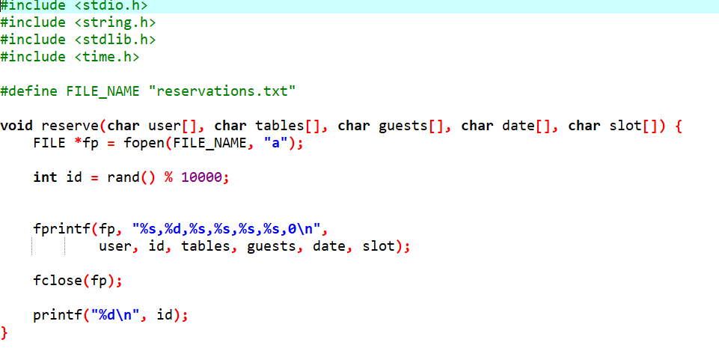
SCREENSHOTS OF RESERVATION MODULE BACKEND

Slide 17
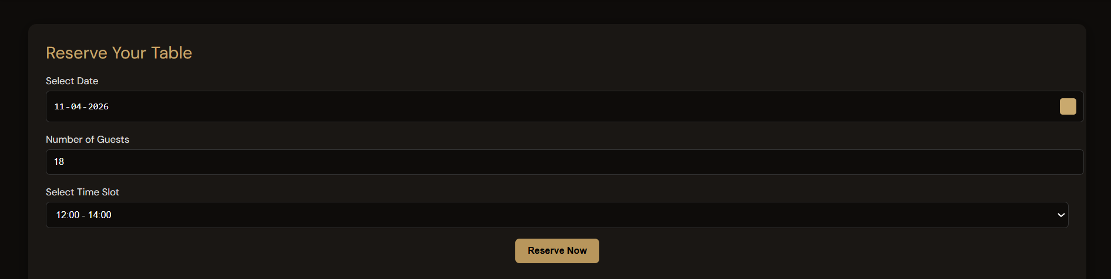
SCREENSHOTS OF RESERVATION MODULE

Slide 18
WORKING WITH JIRA SPRINT 1#
Goal: Develop core reservation system and backend functionality.
Duration: 1-2 weeks
Contributions:
Sahana S - (C Backend – Reservation Engine): Implemented table reservation logic (reserve()), generated unique booking ID and stored reservation details in file system (reservations.txt)
Sakthi V - (C Backend – Cancellation System): Developed cancellation functionality (cancel()), implemented safe file update using temporary file handling

Slide 19
WORKING WITH JIRA SPRINT 1#
Contributions:
Saketh Ram S - Flask Backend – (Integration Layer): Created Flask project structure (FLASK_FOR_HOTEL.py), developed basic routes for reserve and cancel and connected Flask with C backend using subprocess.
Sanjay S - (UI Module): Created initial HTML pages (base.html, home_page.html), designed base layout and initial styling of UI setup.
OUTPUT: Functional C backend, Basic Flask integration and initial UI structure.

Slide 20
WORKING WITH JIRA SPRINT 2#
Goal: To improve UI, complete frontend system, and finalize full integration with notifications
Duration: 1 week
Contributions:
Sahana S - Improved reservation logic stability, fixed table allocation edge cases.
Sakthi V - Enhanced cancellation reliability, improved file consistency handling

Slide 21
WORKING WITH JIRA SPRINT 2#
Contributions:
Saketh Ram S - Completed Flask routes: booking display page, reservation confirmation flow, integrated subprocess output handling (booking ID display), and added session flow improvements
Sanjay S - Fixed UI alignment issues, fixed dark mode datepicker visibility issue. Also added Flask-Mail email notifications: booking confirmation email, cancellation email
OUTPUT: Fully working reservation system, Complete UI, Email notification system, final integration.

Slide 22
MEETING NOTES

Slide 23
CREATING REPOSITORY
Code integrated with JIRA tool using bit bucket

Slide 24
FEEDBACK FROM CLIENT

Slide 25
REFERENCES

Slide 26
Thank You!

